Slide 1



Seasonal trends in leaf non-structural carbohydrates
Linnea Gear
Mentor: Kiona Ogle, Dept. of Informatics and Computing
Northern Arizona University

Slide 2


What are non-structural carbohydrates?
  Soluble sugars
Starch
Immediate functions
  Regulating plant growth
Long-term storage
  Constructing new tissue
2 Linnea Gear
Notes:
COMPARE checking and savings. Sugar like Checking- freely spend, VS starch= savings, save it for later to use in times of need
Sugar and starch are interconvertible

Slide 3
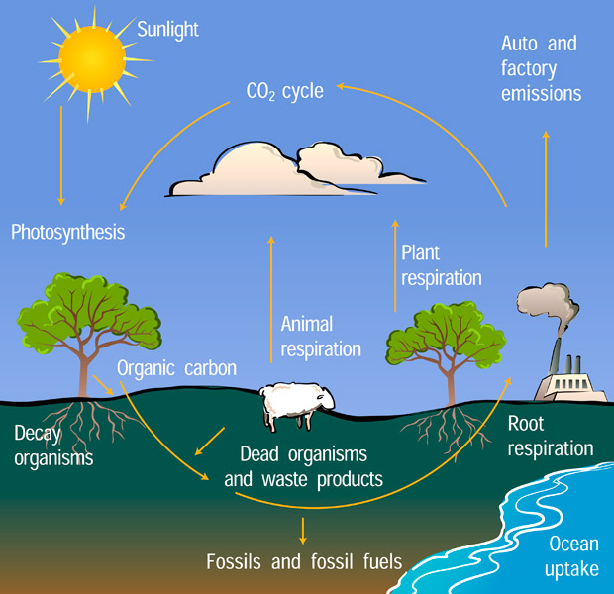
Why are NSCs important?
NSCs
3 Linnea Gear

Slide 4
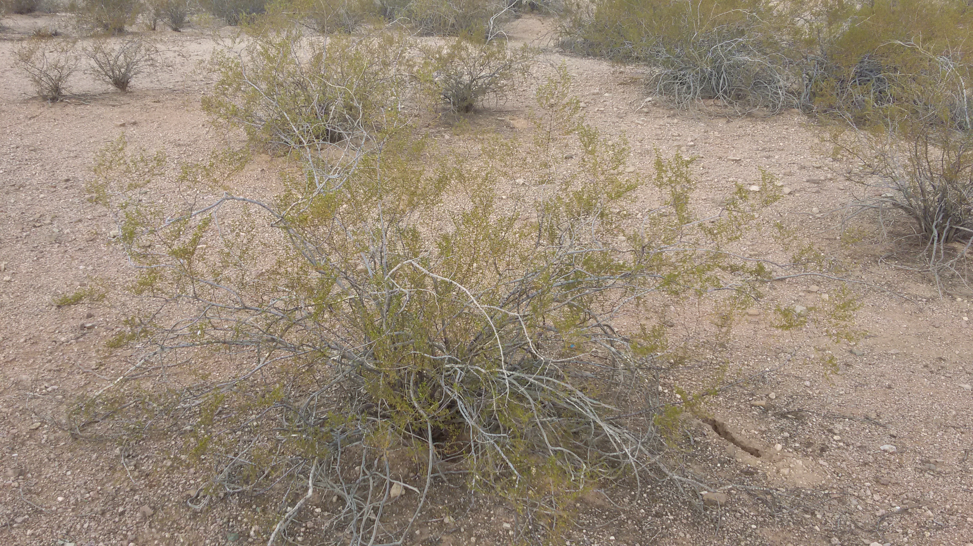
Larrea tridentata (Creosote bush)
Dominant plant of the hot deserts of the Southwest
Extremely drought-tolerant yet evergreen
4 Linnea Gear
Notes:
We studied the NSC dynamics of Larrea tridentata, or creosote bush, which is the dominant shrub in the hot deserts of the Southwest.
This plant is unique in that is is both extremely drought-tolerant and evergreen, which means that it doesn’t lose its leaves during the driest time of year. Its leaves, which are the site of photosynthesis, must be maintained under very hot and dry conditions. We were curious how leaf NSCs would vary seasonally in this evergreen desert shrub.

Slide 5
Seasonal precipitation trends
Average: 169 mm
Total: 130 mm
6 Linnea Gear

Slide 6
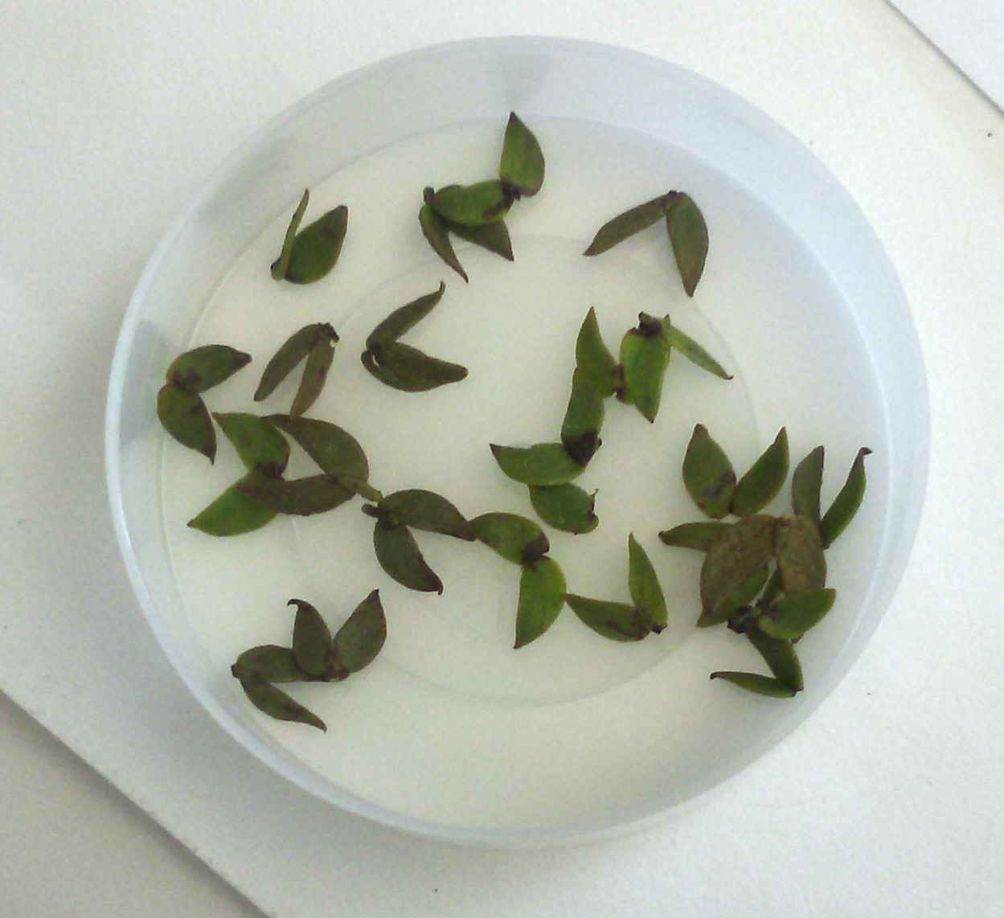
Measuring NSCs in leaves
Leaves collected weekly/monthly from 12 shrubs; 426 samples in total
Phenol and sulfuric acid create a color reaction
Absorbance of the resulting solution can be correlated to sugar/starch concentration
7 Linnea Gear
Notes:
I was instrumental in developing this method. We tested the protocol for 6 months before processing any Larrea samples.

Slide 7
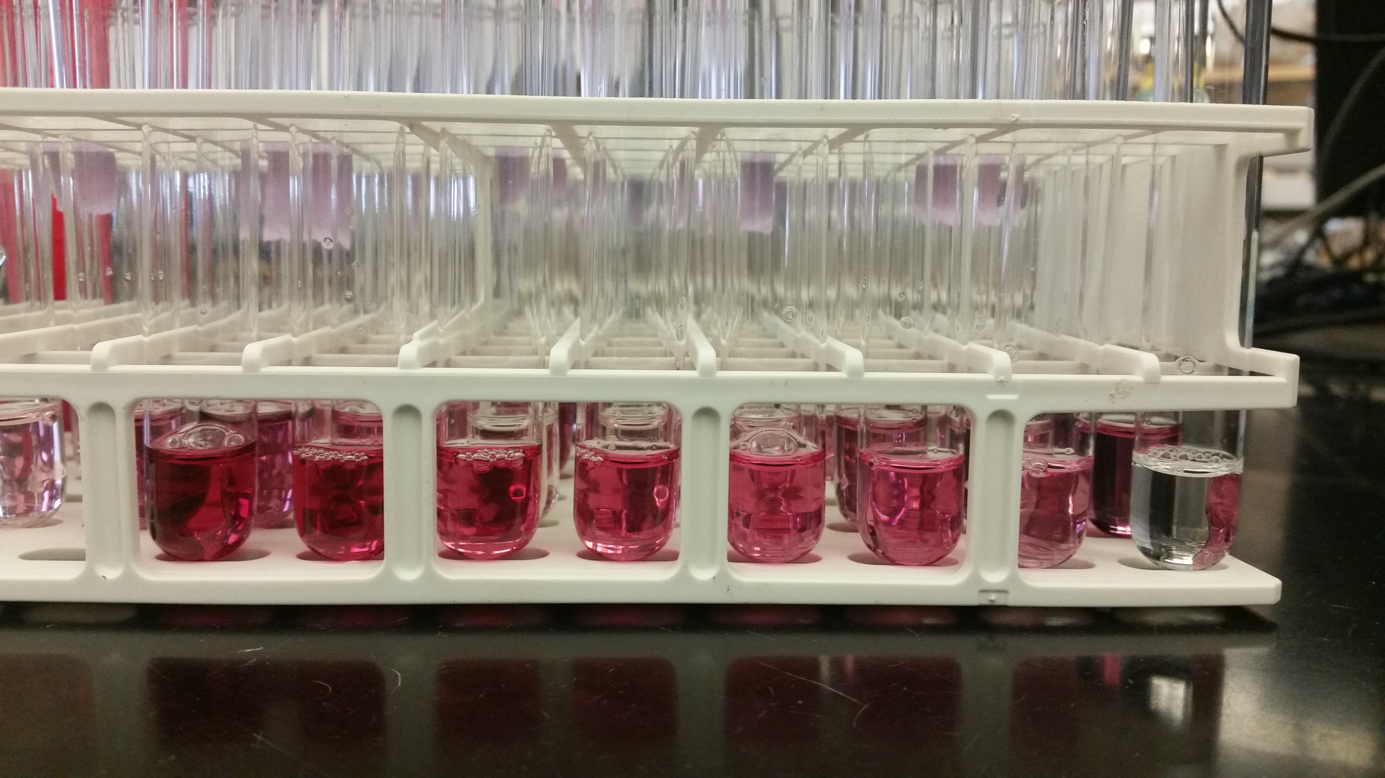
Using a standard curve
8 Linnea Gear
Notes:
Make clear that these are not OUR SAMPLES but known concentrations of sugar and starch

Slide 8
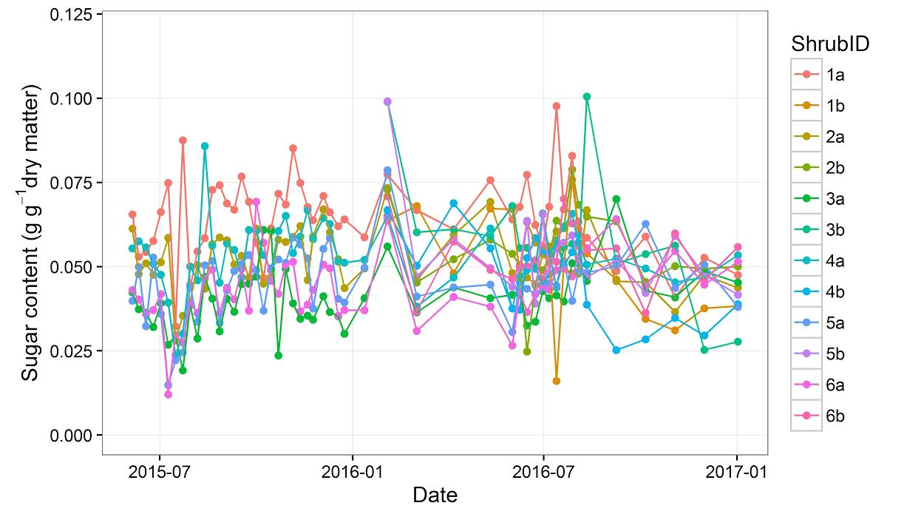
Leaf sugar content
9 Linnea Gear
Notes:
This is a timeseries of leaf sugar content from June 2015 to January 2017. Different colors represent the 12 individual shrubs.
On average, soluble sugars are about 5% of dried leaf weight year round. As we expected, there is minimal seasonal variation in leaf sugar content, though variation among individuals is high.

Slide 9
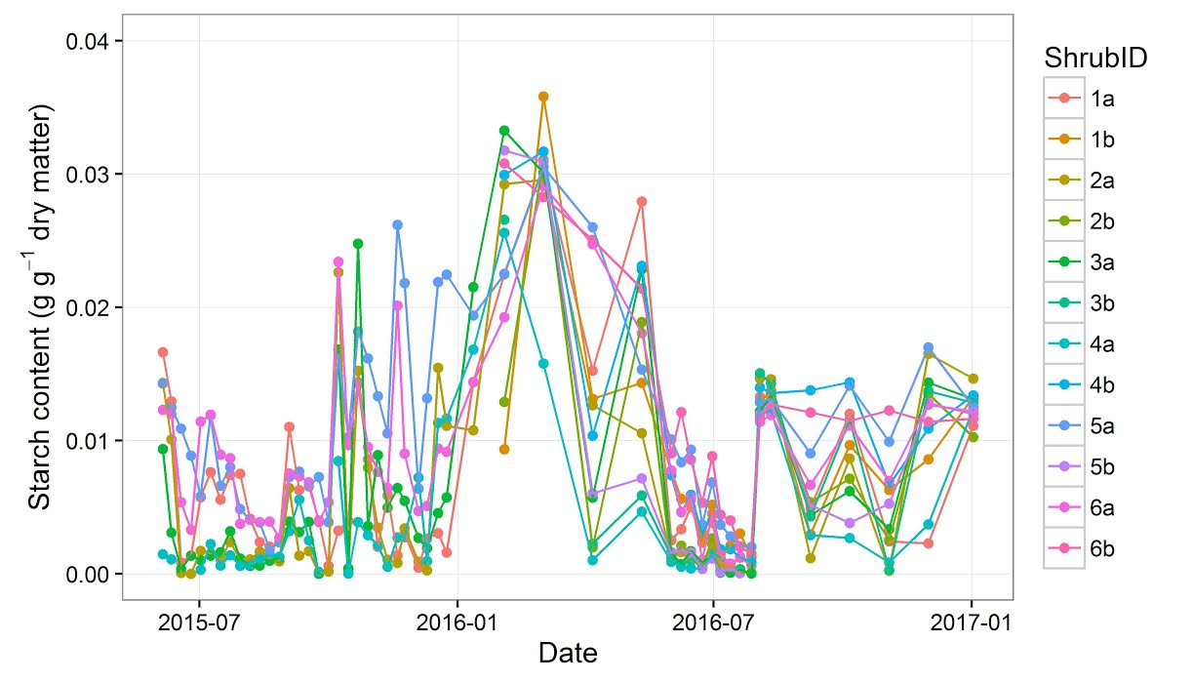
Leaf starch content
10 Linnea Gear
Notes:
This shows the same time series for leaf starch content. We now see a clear seasonal trend
(advance 2 slides)
The top figure shows 2016 precipitation lined up with the starch data. Precipitation peaked in January, followed by a peak in leaf starch 1-2 months later. Then, during the spring and early summer, leaf starch draws down. In June and July, leaf starch get drawn down to almost zero. Then, following the onset of monsoon rain in July, leaf starch reaches a smaller peak in August.
https://cgspace.cgiar.org/bitstream/handle/10568/58319/Cassava%20starch%20content%20and%20its%20relationship%20with%20the%20rainfall.pdf
Winter- good conditions for making sugar and starch because it’s cooler, water evaporates quickly in summer
Winter and summer have different patterns of using starch because of the cool vs. hot temperatures

Slide 10


What does this mean?
Wet
Dry
Sugar content: ~5%
Drawing from savings
Adding to savings
Maintenance costs
Maintenance costs
Growing new tissues
11 Linnea Gear
Notes:
Recall that leaf sugar content hovered around 5% year round. When conditions are wet and photosynthesis rates are high, starch accumulates and the savings account gets bigger, which can be spent on growing new tissue. However, when conditions are dry and photosynthesis rates too low to maintain 5% leaf sugar content, the plant begins to draw from the savings account and only spends what is necessary to maintain existing tissue.
Our findings have important implications. If climate change causes a delay in monsoon arrival, there may be insufficient starch in the savings account to maintain leaf tissues. Even the extremely drought-tolerant creosote may experience negative consequences such as mortality.

Slide 11
Acknowledgments
Desert Botanical Garden
Dr. Kevin Hultine
The Ogle Lab:
Dr. Kiona Ogle
Jessica Guo
Drew Peltier
Stacy Jeffereys
Ryan Bishop
Samuel Teegarden
NASA Space Grant
  Dr. Nadine Barlow
  Kathleen Stigmon

Slide 12
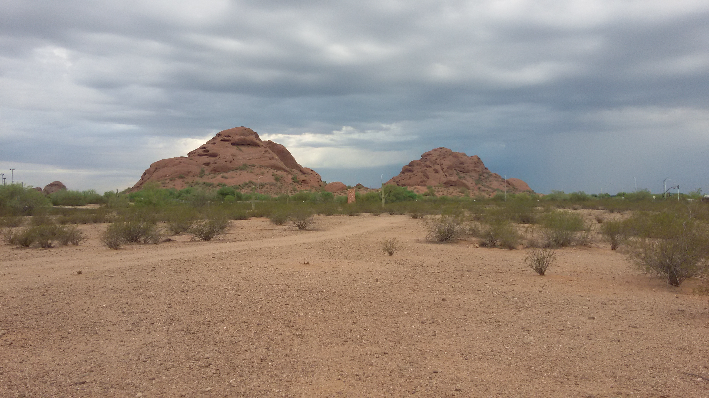
Questions?

